Slide 1

Weekly Update 11
Sarang Deb Saha

Slide 2
Abstract
Road safety remains a critical concern in urban areas, with junctions often serving as hotspots for various traffic violations. The study presents an exploratory analysis of traffic violations in the city of Bengaluru, focusing on data collected from 47 key junctions over a three-month period from Feb to May 2024. Leveraging a comprehensive dataset encompassing various attributes including junction names, observation timestamps, violation types, and vehicle characteristics, our study aims to uncover patterns, trends, and insights relevant to traffic management and safety initiatives.
The analysis begins with data cleaning and preparation, ensuring the integrity and consistency of the dataset. Descriptive statistics provide an overview of the frequency and distribution of violations across different junctions, while visualizations, including Folium maps and heatmaps, offer spatial representations of violation hotspots and patterns. Furthermore, the paper examines the frequency of violations by junction names and vehicle types, highlighting areas of concern and potential intervention. Visualizations illustrate the share of different violation types in the city, shedding light on the relative prevalence of offenses such as over-speeding, red light violations, and non-compliance with safety measures like helmet and seat belt usage. Time series analysis unveils temporal trends in violations, discerning daily, weekly, and monthly patterns to inform targeted enforcement strategies and policy interventions.
Through this exploratory analysis, our paper not only provides a comprehensive understanding of traffic violations in Bengaluru but also offers actionable insights for stakeholders involved in urban planning, law enforcement, and road safety advocacy. By leveraging data-driven approaches, we aim to contribute to the development of effective strategies for promoting safer and more efficient transportation systems in the city.

Slide 3
Problems
IUDX is only getting the data post 5:42PM, Feb 16, 2024. Hence need to re-evaluate our period of analysis (Feb 17 to May 12, 2024 rather than July to September, 2024).
Problems with open-access IMD data.
1 week of data takes atleast an hour and our relevant data would atleast require 5-6 hours.
For number plate data, need to use API from BTP directly not through IUDX. Can get limited number plates but not historical data.

Slide 4
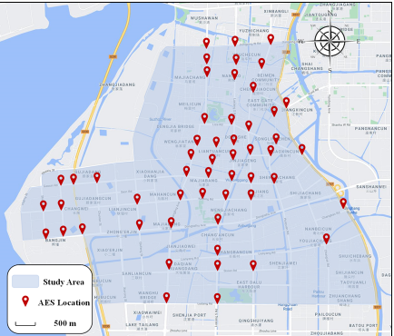
Pinpointing 47 Junctions

Slide 5
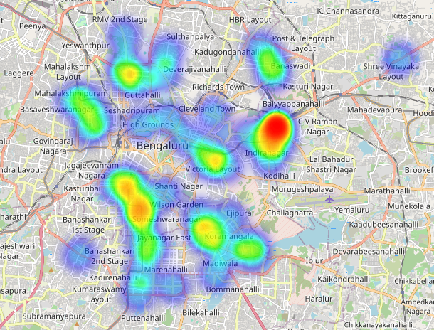
Heatmap of all the violations

Slide 6
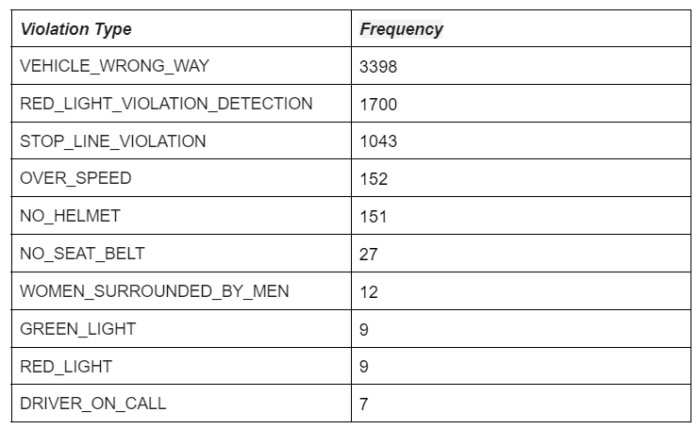
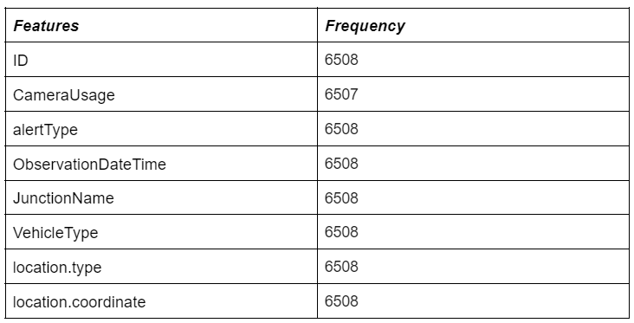
Table 1 Violation type and number detected by ANPRs
Table 2 Description of traffic violation influencing factors*

Slide 7
Analysis and Results
Frequency of Violations by Junction Name
Top 10 of the same and others (maybe pie chart)
Junctions that individually top every violations with frequency
Pie chart of Violations (top 5 and others)
Frequency of vehicle types committing violations
Vehicle wise share individually at every junction
Vehicle wise congestion at these junctions*
Vehicle Type and violation type correlation
Week day wise distribution o violations
Time series analysis
Peak vs Off-Peak comparison for violation based charts

Slide 8
Story based or case study based
Visualizations and Insights based on all 47 Junctions and a zoomed out perspective and a general view and reasons behind the violations.
Selecting the 2 specific junctions that might highlight the trend in a particular violation class and give insights and reasons based on that particular violation and then using these to relate to the other 47 junctions.

